Slide 1
Project Report on OSDA Yuan Wei
Faculty of Computer Science
Data Science
Project Based on Titanic Survivor Predictions

Slide 2
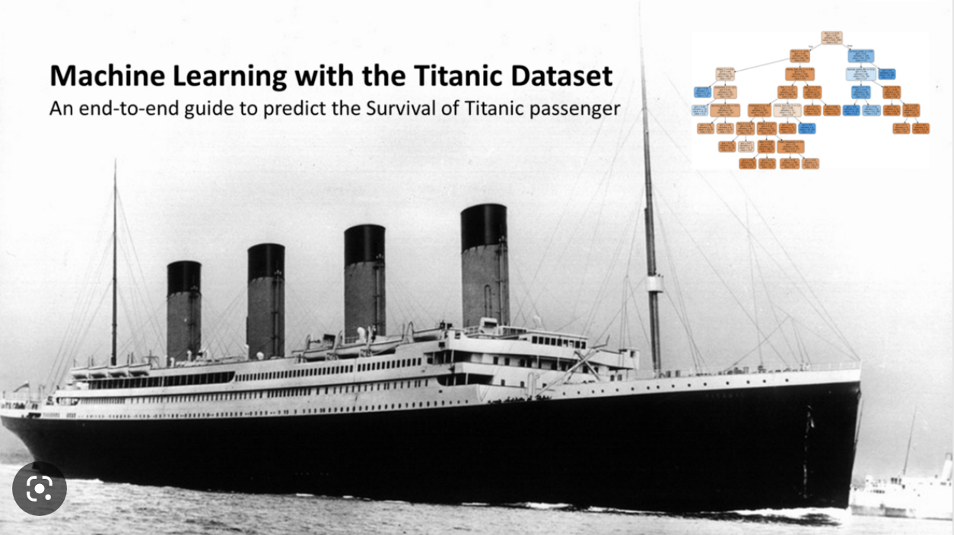
Background
Titanic: An Olympic-class liner of the British White Star Line, construction began on 31 March 1909 at the Harland & Wolff shipyard in Belfast Harbour, Ireland, was launched on 31 May 1911 and completed for sea trials on 2 April 1912.
First voyage: 10 April 1912
Route: From Southampton, England, via Cherbourg-Octeville, France, and Queenstown, Ireland, to New York, USA.
Shipwreck: 15 April 1912 (hit an iceberg at around 2340 hours on 14 April 1912)
Number of crew + passengers: 2224
Number of people killed: 1502 (67.5%)

Slide 3
Overview
7 Steps of workflow
Passenger ID
Survived: 1-38% 2-62%
Pclass:1,2,3
Name
Sex
Age:missing 20% data
Sibsp:1-8
Ticket number
Parch
Fare
Cabin
Embarked
Question or problem definition.
Acquire training and testing data
Wrangle, prepare, cleanse the data.
Analyze, identify patterns, and explore the data.
Model, predict and solve the problem
Visualize, report, and present the problem solving steps and final solution.
Supply or submit the results.

Slide 4
Title Title
dataset.Name.str.extract( " ([A-Za-z]+)." , expand = False)
Extracted from the name, related to the name and social status
FamilySize Family size
Parch + SibSp + 1
Intermediate feature used to calculate whether the IsAlone feature travels alone, kept for now
IsAlone alone
FamilySize == 1
Whether travelling alone or not
HasCabin has a separate cabin
Not sure if the sample without CabinId has no cabins or if the data does

Slide 5
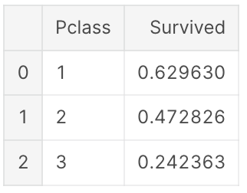
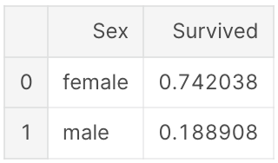
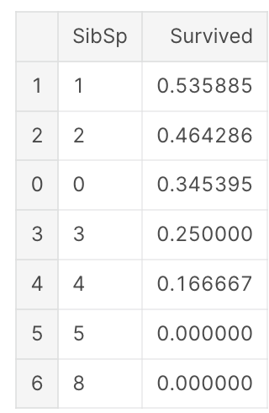
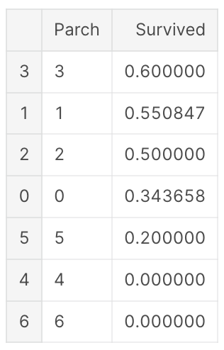
Correlation of several enumerated features with Survived (direct group aggregation for mean value)

Slide 6
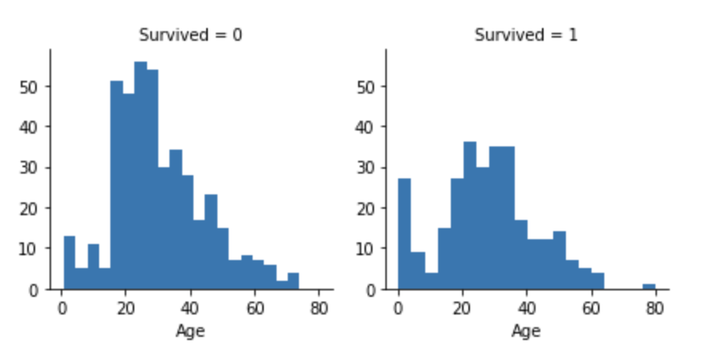
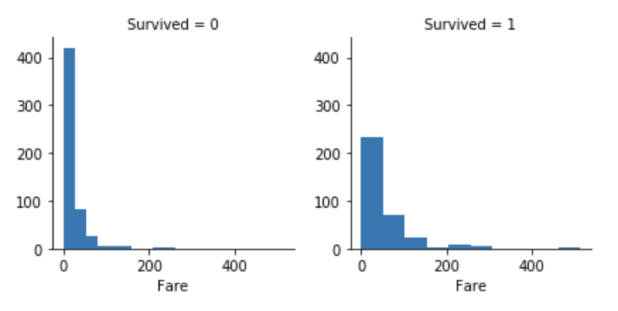
Histograms are used for long span characteristics such as age to see the distribution of survivors and non-survivors separately

Slide 7
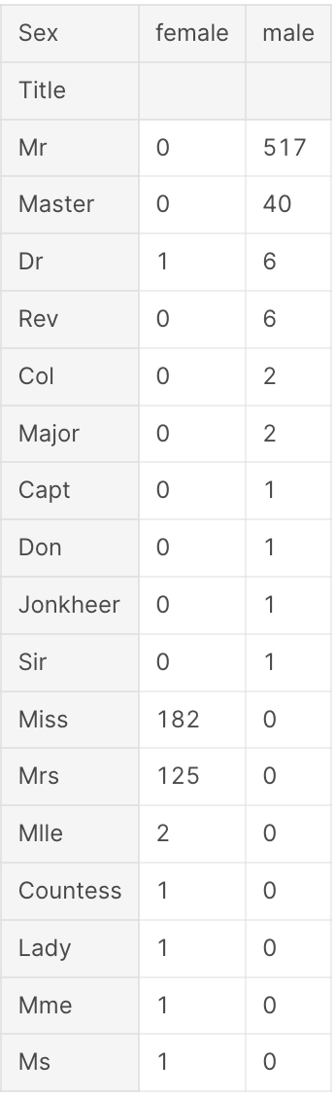
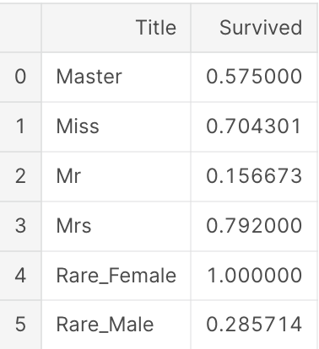
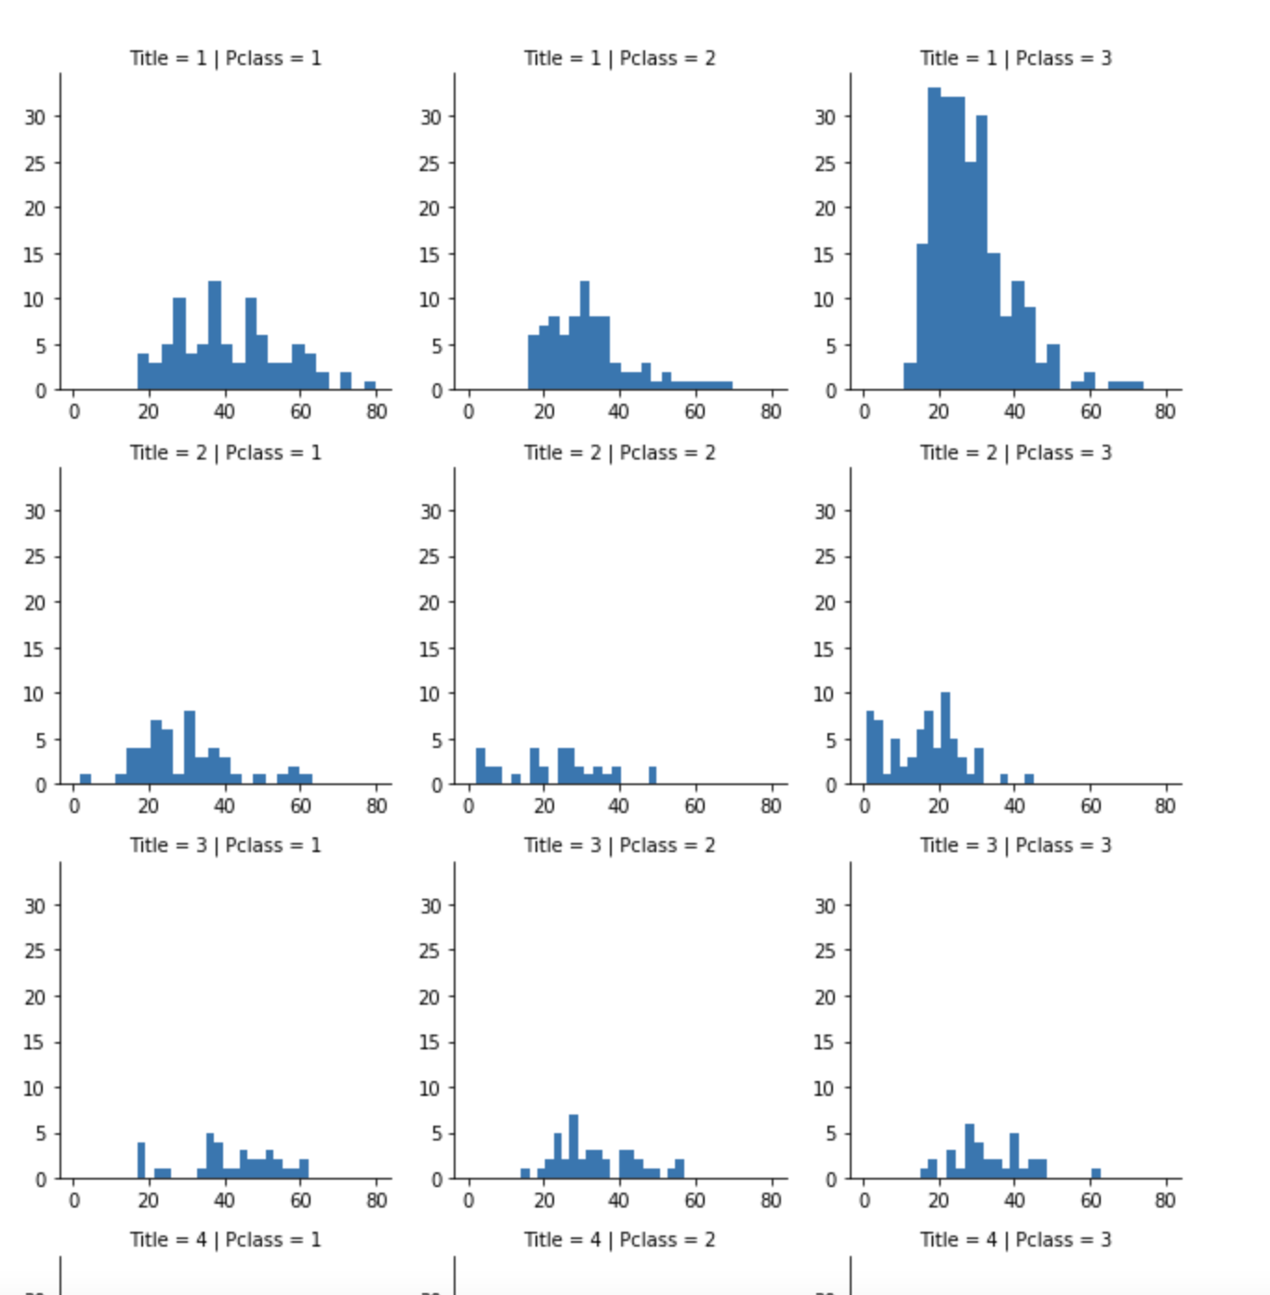
Feature Cleaning
Name,Cabin,Ticket
TItle-Categorization
Sex
Age-prediction
Fare-prediction
IsChildren
IsAlone
FamilySize

Slide 8
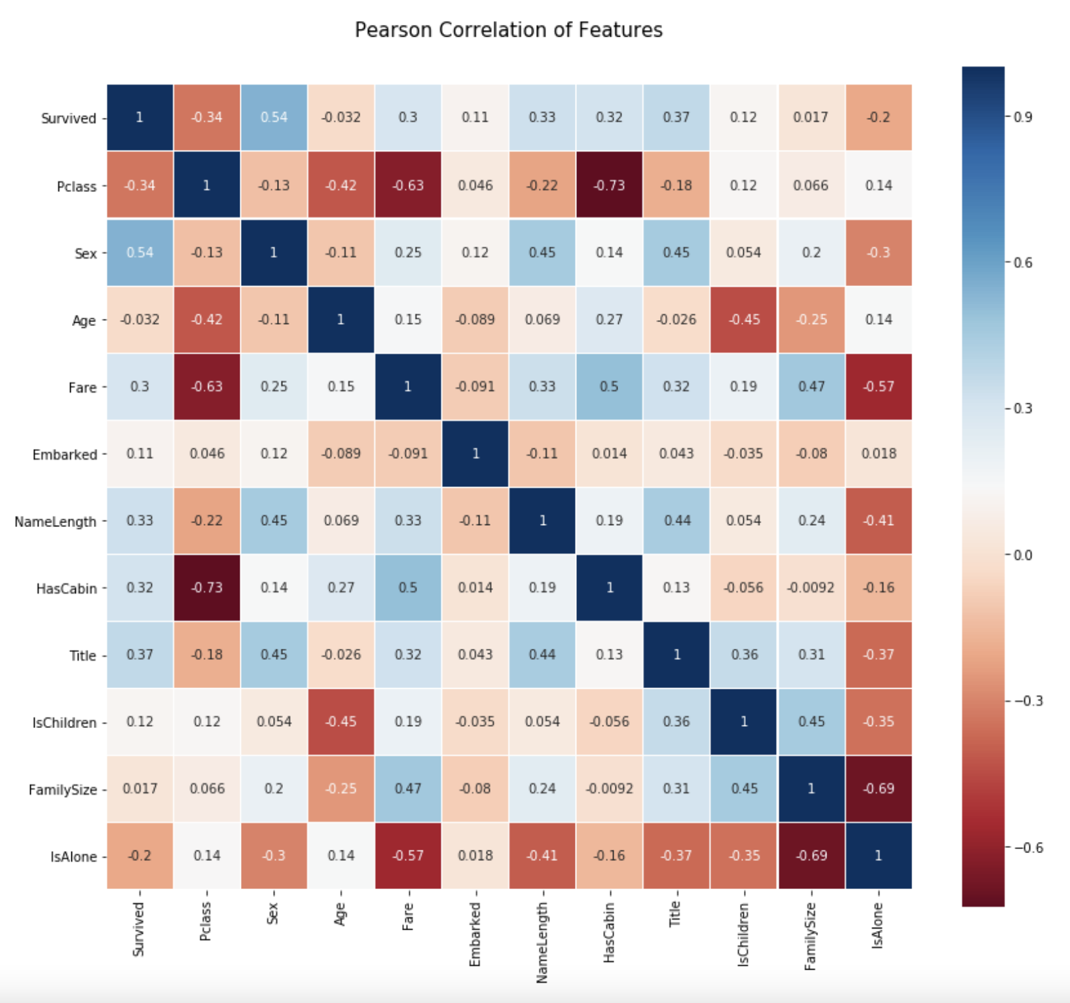
Feature correlation visualization Visualize correlations between features using seaborn's heatmap

Slide 9
Model | Accuracy | Precision | Recall
LazyFCA | 79.05 | 0.35 | 0.20
Logistic Regression | 82.15 | 0.76 | 0.70
Support Vector Machines | 83.28 | 0.81 | 0.72
KNN | 85.30 | 0.81 | 0.67
Decision Tree | 88.78 | 0.79 | 0.69
Random Forest | 83.15 | 0.80 | 0.71

Slide 10
Thank you!

